Slide 1
Python

Slide 2
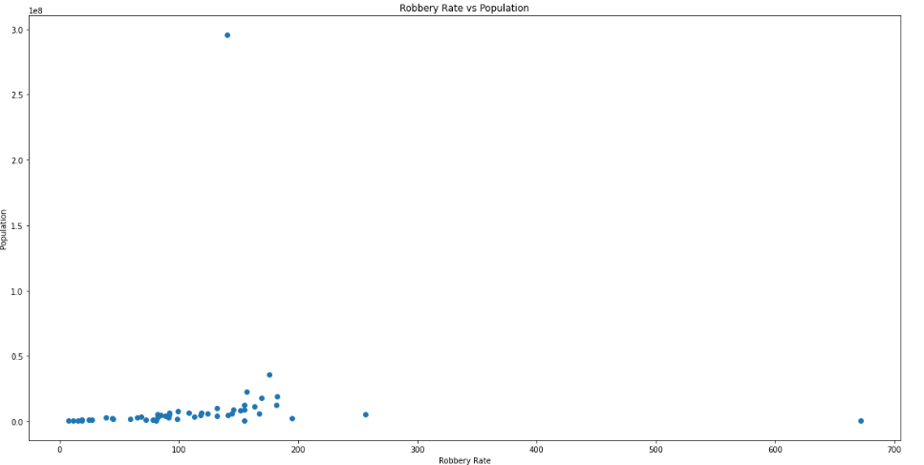
Python – Scatter Plot

Slide 3
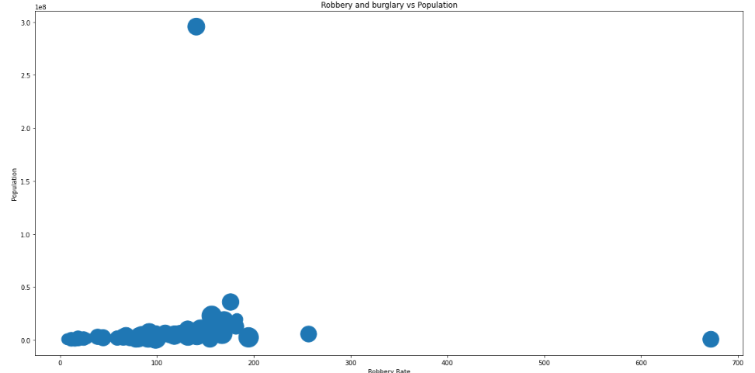
Python – Bubble Chart

Slide 4
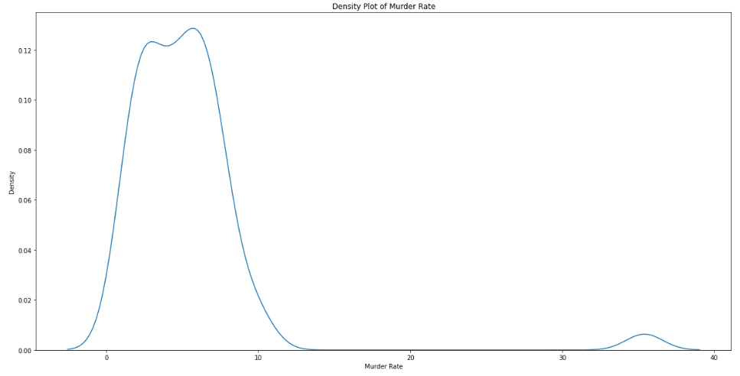
Python – Density Plot

Slide 5
Power BI

Slide 6
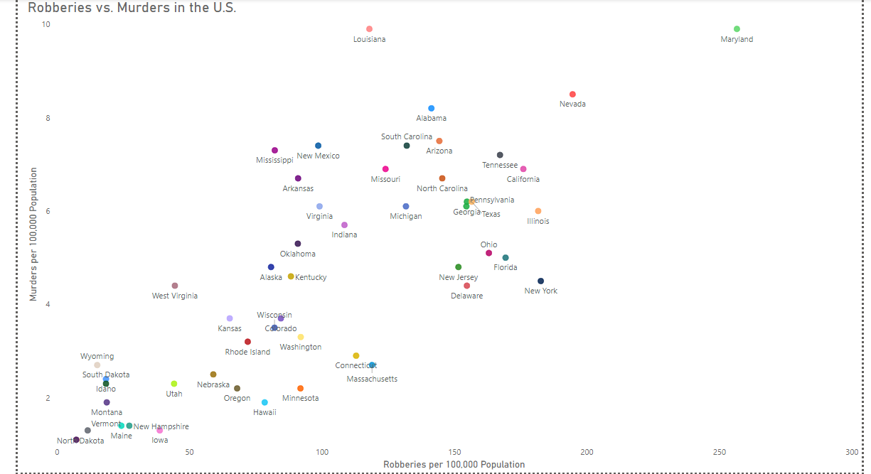
Power BI – Scatter Plot

Slide 7
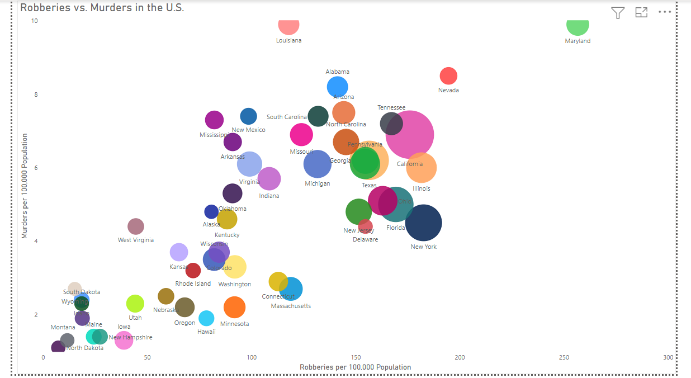
Power BI – Bubble Chart

Slide 8
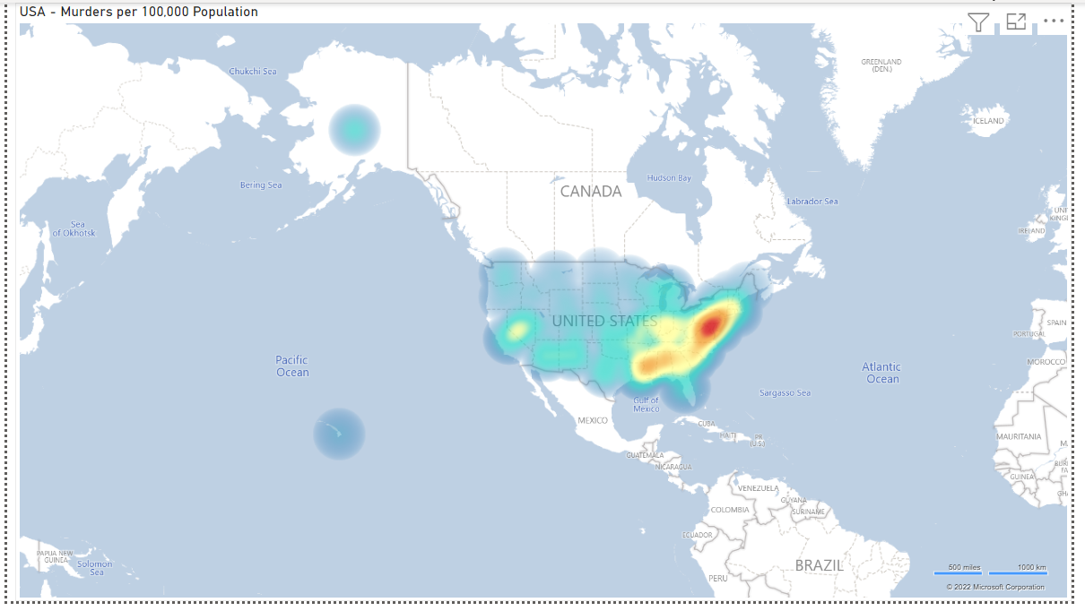
Power BI – Density Map

Slide 9
R

Slide 10
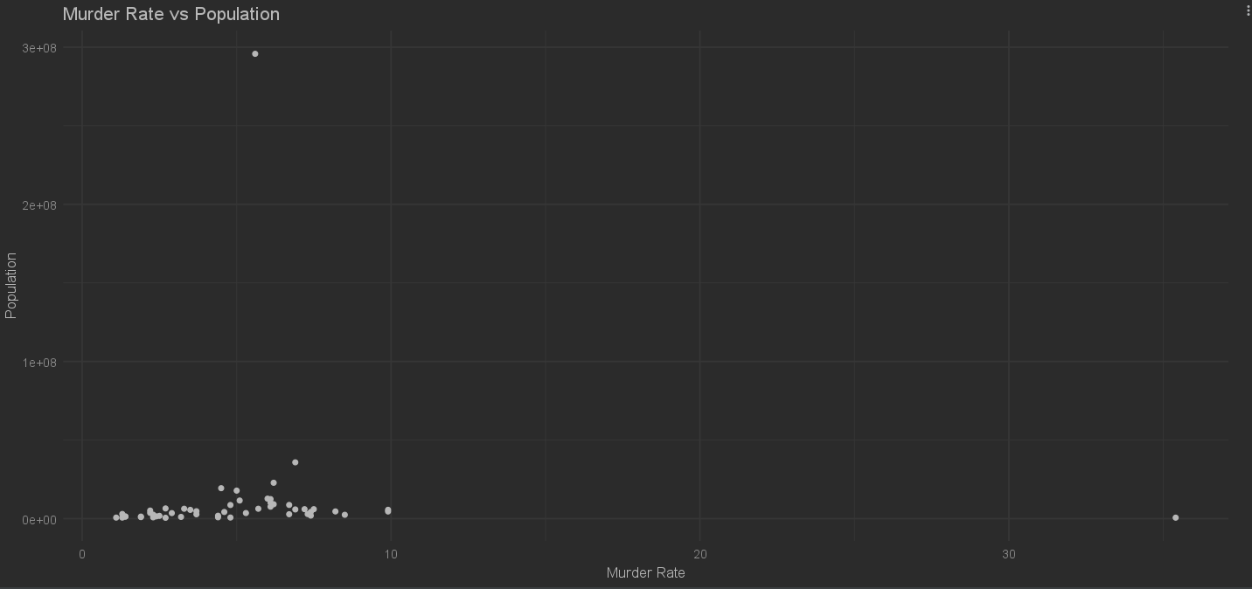
R – Scatter Plot

Slide 11
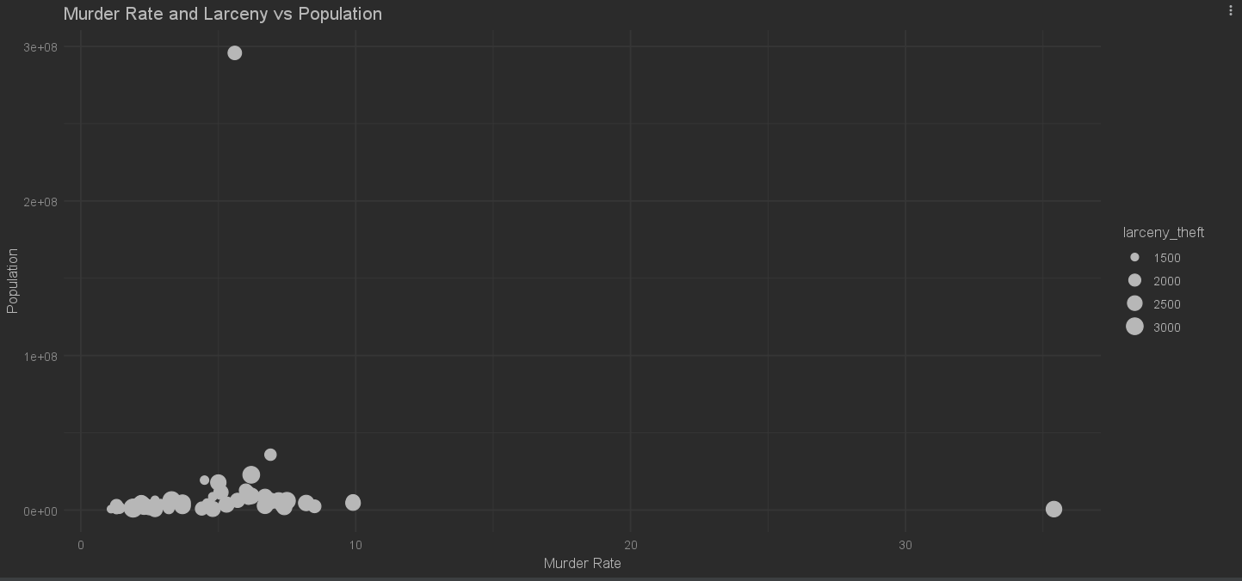
R – Bubble Chart

Slide 12
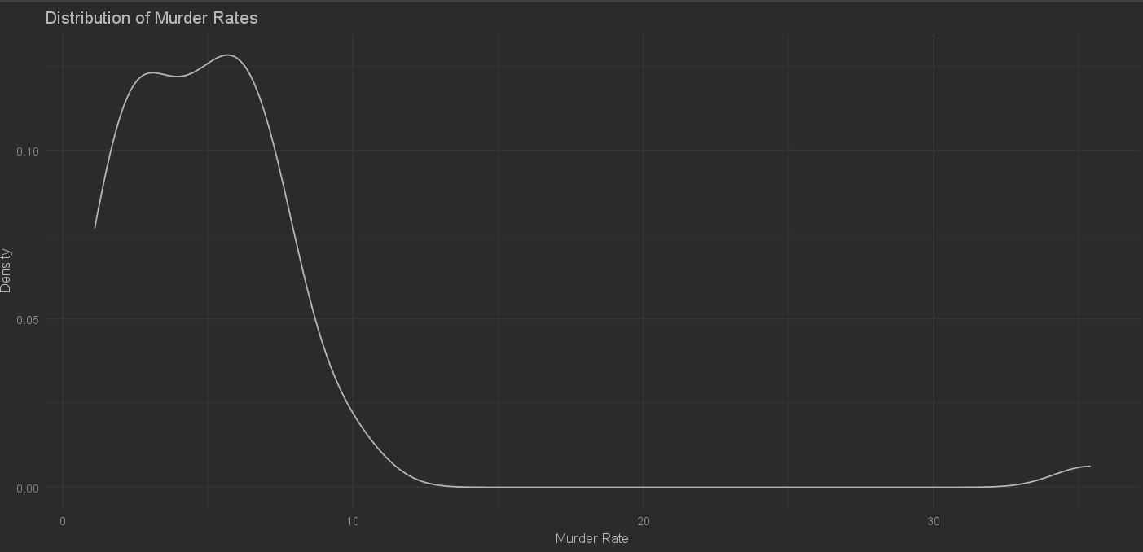
R – Density Plot

